Slide 1

Verlixir: Verification of Message-Passing Systems
Matt Neave

Slide 2
Why must we verify systems?
Java System
Java System
How do we know it’s correct?
Maintain both…
TLA+ Model

Slide 3
Can we do better?
Java Implementation
TLA+ Specification
H(self) == /\ pc[self] = "H"
/\ \/ /\ IF state[self]="Thinking"
THEN /\ state' = [state EXCEPT ![self] = "Hungry"]
ELSE /\ TRUE
/\ state' = state
/\ pc' = [pc EXCEPT ![self] = "J0"]
\/ /\ pc' = [pc EXCEPT ![self] = "P"]
/\ state' = state
\/ /\ pc' = [pc EXCEPT ![self] = "T"]
/\ state' = state
/\ fork' = fork
// thinking
System.out.println(“Thinking”);
sleep(((int) (Math.random() * 100)));

Slide 4
Verification-aware Languages
Programming language designed with built-in constructs to facilitate the verification of the program’s correctness
For example, Dafny
Safety and liveness
method Abs(x: int) returns (y: int)
ensures 0 <= y
{
if x < 0 {
return -x;
} else {
return x;
}
}
specification
code

Slide 5
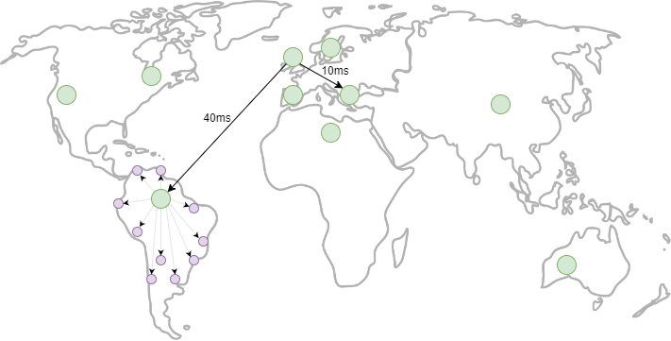
Why must we verify message-passing systems?

Slide 6

Elixir
Functional, concurrent, high-level programming language
Builds on top of Erlang – sharing abstractions for distribution and fault-tolerance

Slide 7
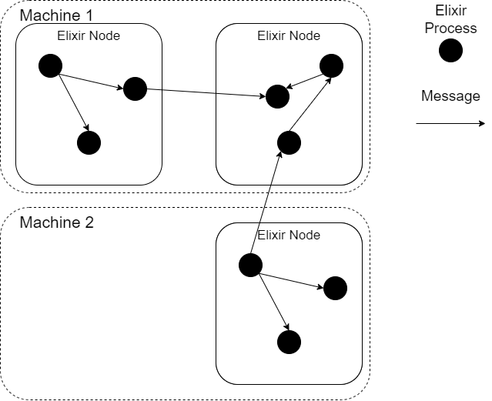
Elixir
# Spawn a new process
spawn(fn -> 1 + 2 end)
# Create a new BEAM instance Node.spawn(:"node1@localhost",
MyModule, :start, [])

Slide 8
Making Elixir verification-aware
Processes ✅
Sending ✅
Receiving ✅
Matching (assignment) ✅
Types and data structures (lists) ✅
For comprehensions, higher order functions ✅
Function overloading ❌
Maps, sets, tuples ❌
Floats, math functions (square root…)❌

Slide 9
Elixir by example
@spec start_coordinator() :: :ok
def start_coordinator do
client_count = 100
server_count = 10
load = 10
servers = for server <- 1..server_count do
spawn(Server, :start_server, [load, self()])
end
bind_servers(servers, server_count, load)
for _ <- 1..server_count do
receive do
{:server_done, server} -> :ok
end
end
IO.puts "All servers done"
end

Slide 10
Verlixir
Verification-aware programming language for message-passing systems
Verification and simulation
Built in specification language
Model parameterisation

Slide 11
Verlixir by example
Entry point for Verlixir
defmodule Coordinator do
@init
@spec start_coordinator() :: :ok
def start_coordinator do
client_count = 100
server_count = 10
… spawn and link servers / clients …
end
end

Slide 12

Verlixir Verifier - Making Elixir Verification-aware
Deadlock and livelock detection, for FREE
Linear temporal logic (LTL) to reason about time and change
Design-by-Contract functions using pre- and post-conditions
Predicates

Slide 13
Verlixir modelling
defmodule Coordinator do
@init
@spec start_coordinator() :: :ok
def start_coordinator do
client_count = 100
server_count = 10
… spawn and link servers / clients …
end
end
active proctype start_coordinator () {
chan ret1 = [1] of { int };
chan ret2 = [1] of { int };
int __pid = 0;
atomic{
if
::__pid==-1 -> __pid = _pid;
::else->skip;
fi;
}
int client_count = 100;
int server_count = 10;
. . . spawn and link servers / clients . . .
printf("All servers done\n");
}

Slide 14
Verlixir modelling - Promela
No functions
No recursion
No (dynamic) data structures
Statically typed

Slide 15
Verlixir Simulator
./verlixir –s distributed_braodcast.ex
Starting global broadcast…
South-America broadcasting…
EU-South broadcasting…
…
All client acknowledgements received
Because of delays, real-world system may not observe this interleaving for hours / days / weeks…

Slide 16

Verlixir Verifier: Deadlocks
Dining philosophers – classical deadlock problem
Philosophers need two forks to eat!

Slide 17
Verlixir Verifier: Deadlocks
Dining philosophers – classical deadlock problem
Philosophers need two forks to eat!
Some simulations output:
Others output:
Picking up 1
Picking up 2
Picking up 2
Picking up 1
All philosophers have finished eating!
Picking up 1
Picking up 2
Picking up 1
Picking up 2
timeout

Slide 18
Verlixir Verifier: Counterexamples
Verlixir verification mode produces counterexample!
verlixir –v dining_philosophers.ex
Model ran successfully. 1 error(s) found.
The program likely reached a deadlock. Generating trace.
(proc_1 - fork_loop) recv [PICKUP, phil1]
(proc_1 – fork_loop) send [ACK, phil1]
(proc_2 – fork_loop) recv [PICKUP, phil2]
(proc_2 – fork_loop) send [ACK, phil2]
(proc_2 – fork_loop) recv [PICKUP, phil1]
(proc_1 – fork_loop) recv [PICKUP, phil2]
timeout
Both forks have been picked up!

Slide 19
Verlixir Verifier: LTL
Same as deadlock counterexamples, Verlixir will produce counterexamples violating LTL formula
defmodule Atm do
@ltl """
<>(card_inserted)
[](card_inserted->(<>[](transaction_failed)||<>[](atm_balance<1000)))
"""
def start_atm do
atm_balance = 1000
card_inserted = false
transaction_failed = false
... implementation ...
do
end

Slide 20
Verlixir Verifier: contracts
Introduce pre- and post-conditions with Verlixir contract
defv add(x, y), pre: x > 0 && y > 0, post: z == x + y do
... defines z somehow ...
end
`defv` introduces a contract

Slide 21
Verlixir: properties
Simplify LTL claim readability
Used as expression conditions
@ltl "[](new_round -> <>(consensus)"
def run do
predicate new_round, messages_received == 0 && messages_sent == 0
predicate consensus, messages_received >= number_of_nodes / 2 + 1
...
if new_round do
...
end
end

Slide 22
Verlixir Verifier: parameterisation
Model different configurations of variables
@model {:client_count, :server_count}
def start_coordinator do
client_count = 100
server_count = 10
… spawn and link servers / clients …
end

Slide 23
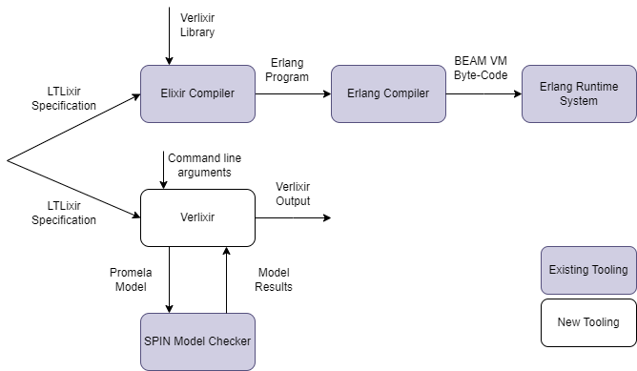
High-level Overview
Verlixir Program
Verlixir Program

Slide 24
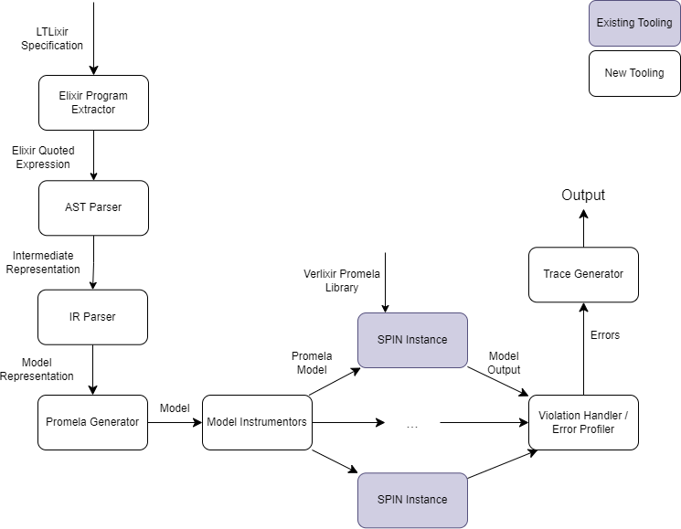
Verlixir System

Slide 25
Evaluated algorithms
Algorithm | Elixir Size | Promela Size
Basic Paxos | 3 modules, 157 lines | 702 lines
Consistent Hash Ring | 2 modules, 135 lines | 579 lines
Dining Philosophers | 4 modules, 137 lines | 624 lines
Two-phase Commit | 3 modules, 167 lines | 777 lines
Raft (Leader Election) | 2 modules, 83 lines | 525 lines

Slide 26
Summary
Message-passing systems are interesting
Verlixir is a verification-aware language for writing distributed algorithms
Support for LTL, properties, contracts…
Verification…
Simulation…
Model checked with Spin!

Slide 27
Future Work
Fault injection
Computation-tree logic (CTL) support
Support more Elixir / other frontends / other backends

Slide 28
Final Remarks
Safety and liveness
Verification-aware languages
Generative AI

